Slide 1

Online Banking Management System
FINAL REPORT
TEAM MEMBERS:
1. MANOJKUMAR M – 19Z226
2. NANDHA KISHORE V – 19Z228
3. RAHUL RAJ D – 19Z234
4. SANJAI S – 19Z242
5. VIVEKANANDHAN S– 19Z261
6. HARISH N R – 20Z431

Slide 2

CONTENTS
INTRODUCTION
PROBLEM STATEMENT
OBJECTIVE
SDD
SCREENSHOTS OF WEBPAGE

Slide 3
INTRODUCTION
A Online Banking Management System is a project that manages and collects data according to customer’s needs.
This system helps customer to create their account , enquire balance in a easy manner.
It also helps the bank manager/admin to keep their data updated and constant track of them.
It also allows the customer’s to request for loan and insurance which will verified by the manger, and he can either approve or reject or sort to waiting list.

Slide 4

PROBLEM STATEMENT
To update the manual banking records into an internet-based application. This application can be used both by customer and banking admins.

Slide 5

OBJECTIVES
The application objective is to reduce the manual work of the customer to go to bank and filling their application manually to get it verified by the manager.
Here the account opening forms can be directly submitted in the website and also the debit, credit card formalities.
It allows the customer to keep track of their account constantly.

Slide 6

Requirements gathering MODULES
ADMIN PORTAL
Login
Approve/ reject the account requests
View the accounts data
- pending
- approved
- rejected
Balance Update

Slide 7

Requirements gathering MODULES
CUSTOMER PORTAL
Login
Create new account opening request
Request for credit/ debit card
Enquiring the balance

Slide 8
ADMIN PORTAL
Login – Dashboard
This module allows the admin to login into the portal and view the functionalities
1. Account Section
2.Loan Section
3.Card Section
4.Insurance Section
5.Gold Loan Section
This module contains all the functionalities an admin can perform in the application. Its further divided into four modules as listed below.

Slide 9

ADMIN PORTAL
Approve or reject the requests
This module allows the Admin to approve / reject / keeping the request from the customer in pending list just by verifying the details of the customer
When we CLICK APPROVE the data will be reflected in the portal of the customer

Slide 10

ADMIN PORTAL
View – Functionality Status
This module allows the admin to view the functionality status
pending
approved
rejected

Slide 11

ADMIN PORTAL
Balance Update
This module allows the admin to view and update the balance according to the account number of the customer.
This functionality will work only after the verification of account is done.

Slide 12

CUSTOMER PORTAL
LOGIN – DASHBOARD:
This module allows the admin to login into the portal and view the functionalities:
Create Bank Account
Balance Enquiry
Request for Debit/ Credit Card
View ATM Approval
Request for Loan
View approval for Loan

Slide 13

CUSTOMER PORTAL
CREATE BANK ACCOUNT:
This functionality allows the customer to request to create the bank account by entering the valid details.
BALANCE ENQUIRY:
The customer can view their account balance by using their account number and entering their username.
SENDING AND VIEWING THE REQUEST:
This module helps the customer to send the request for ATM, Loan and view their status of approval.

Slide 14
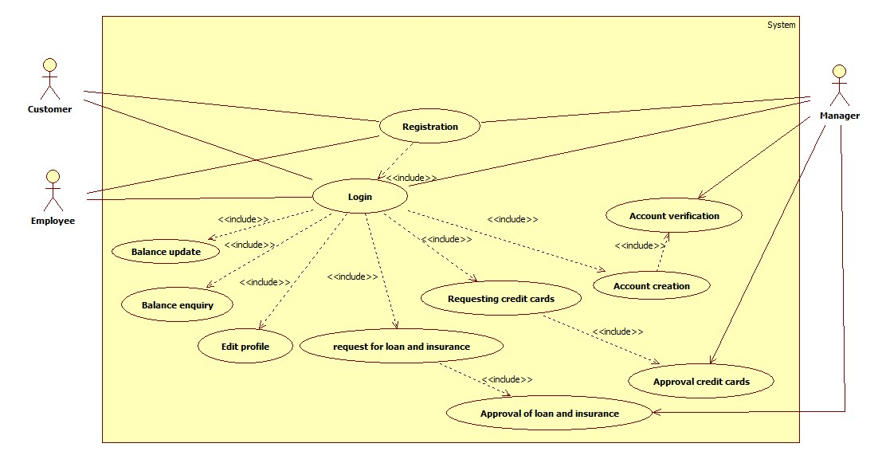
USE CASE DIAGRAM

Slide 15
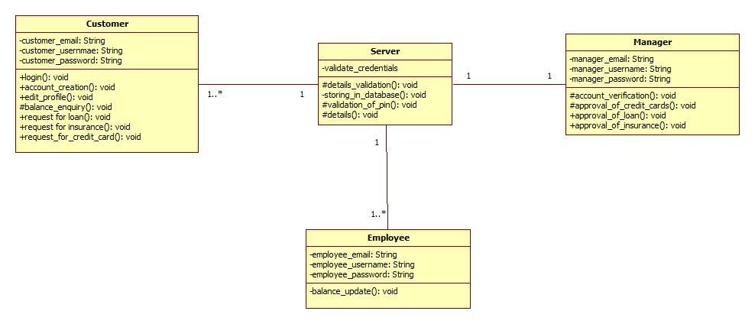
CLASS DIAGRAM

Slide 16
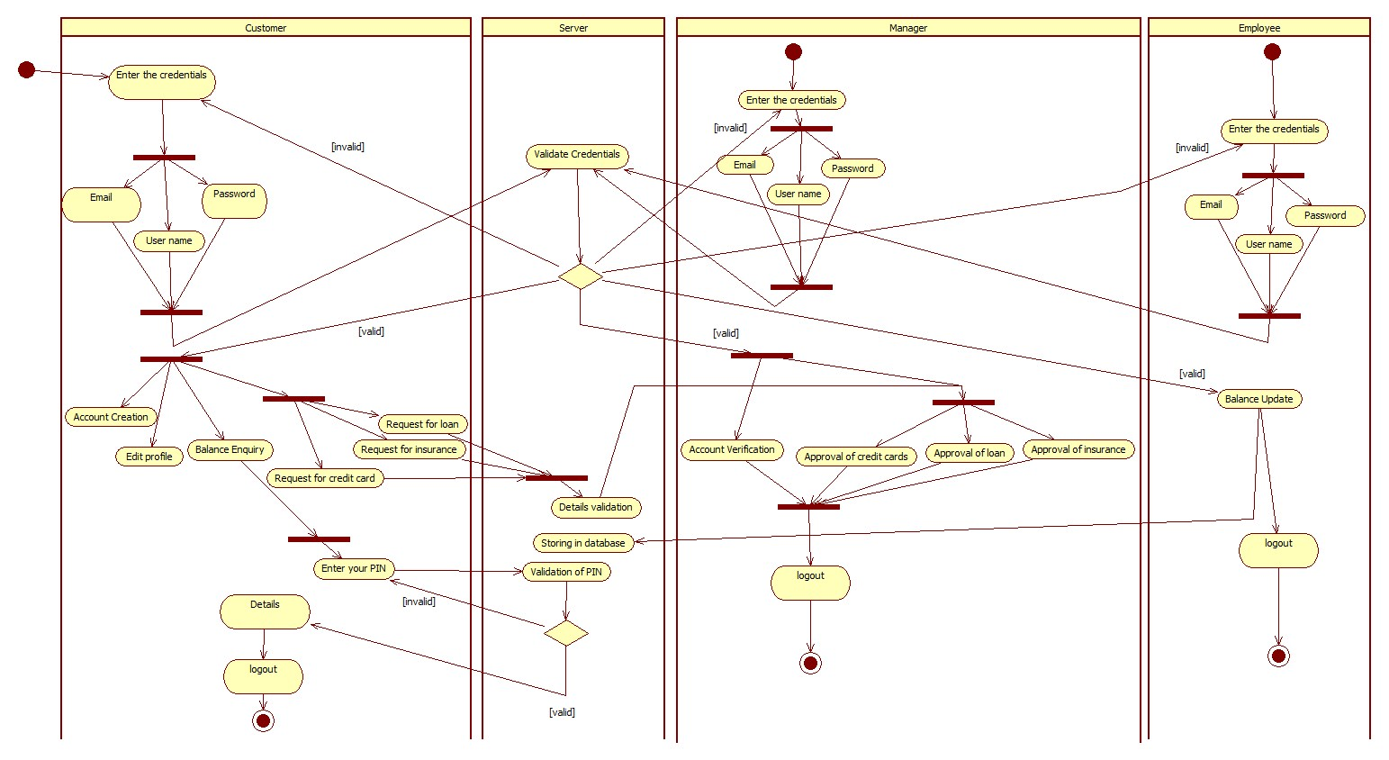
ACTIVITY DIAGRAM

Slide 17
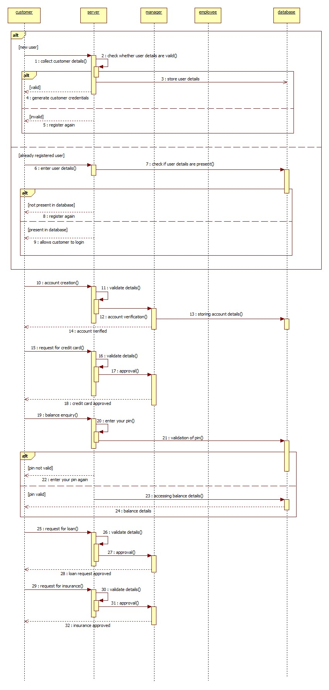
SEQUENCE DIAGRAM

Slide 18
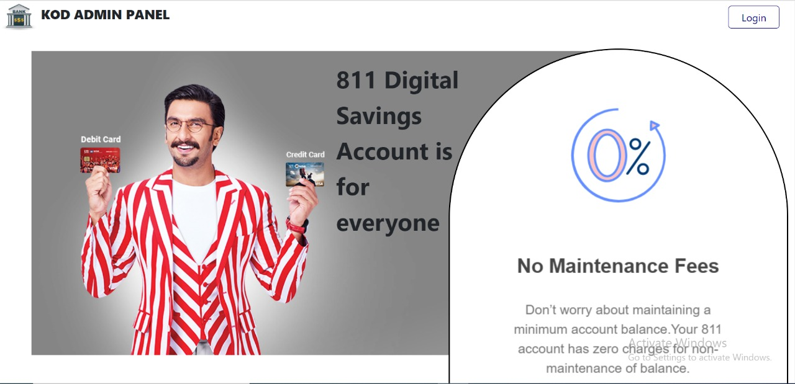
SCREENSHOT OF THE HOME PAGE

Slide 19
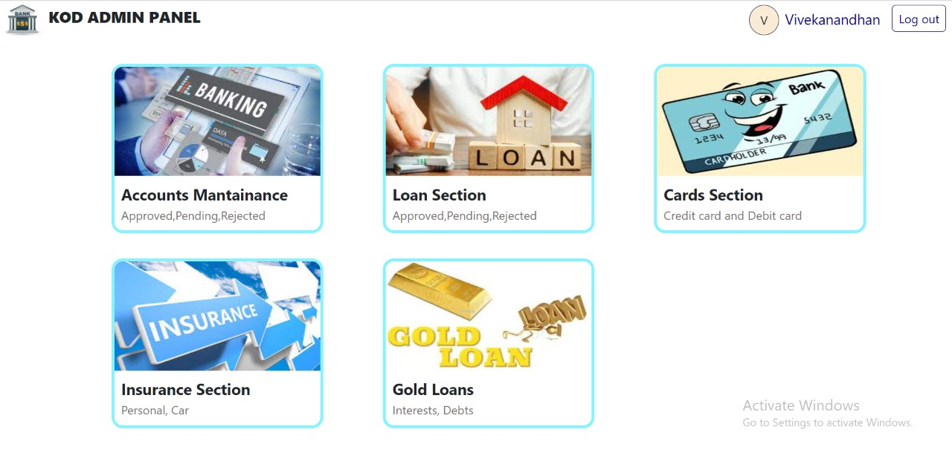
SCREENSHOT OF ADMIN PANEL

Slide 20
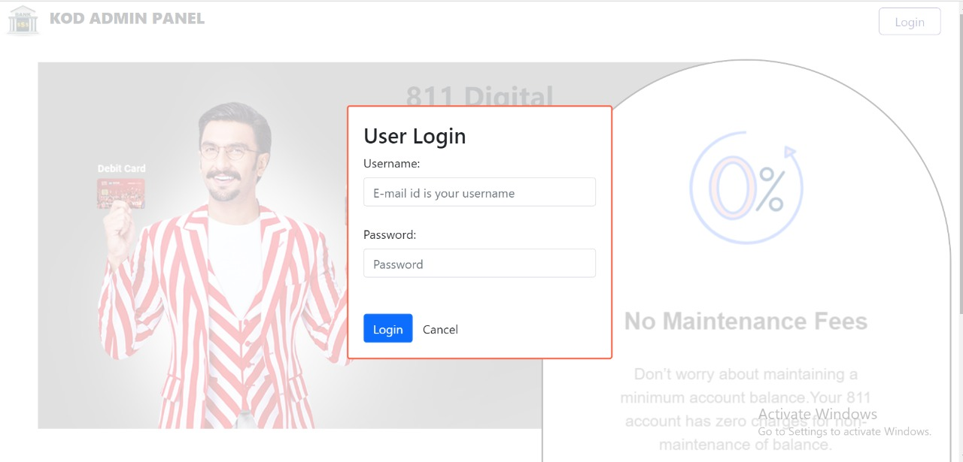
SCREENSHOT OF LOGIN INTERFACE IN ADMIN PANEL

Slide 21
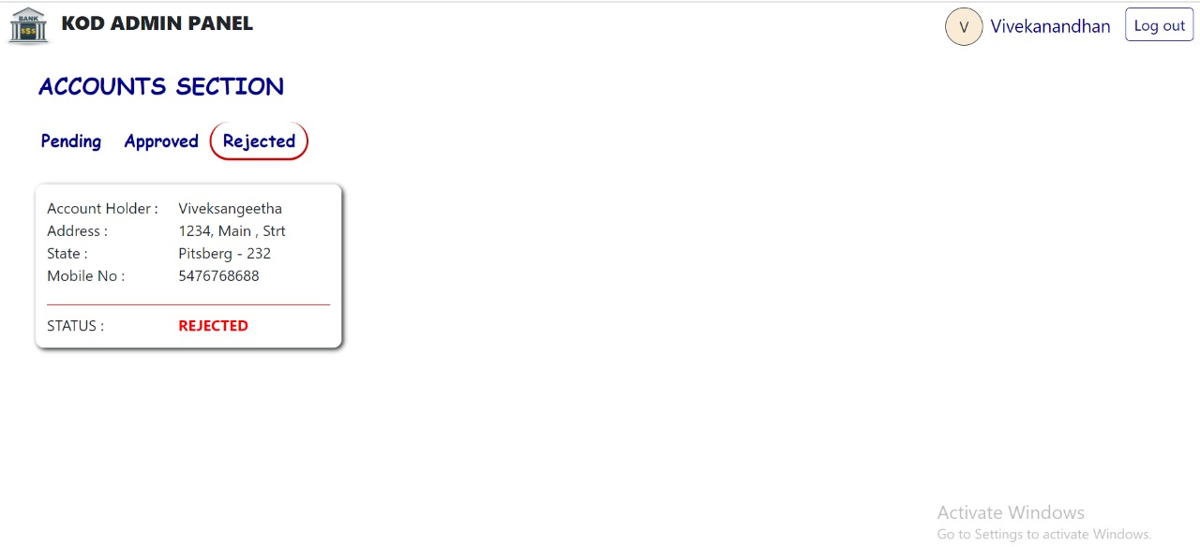
SCREENSHOT OF ACCOUNTS SELECTION MENU - REJECTED

Slide 22
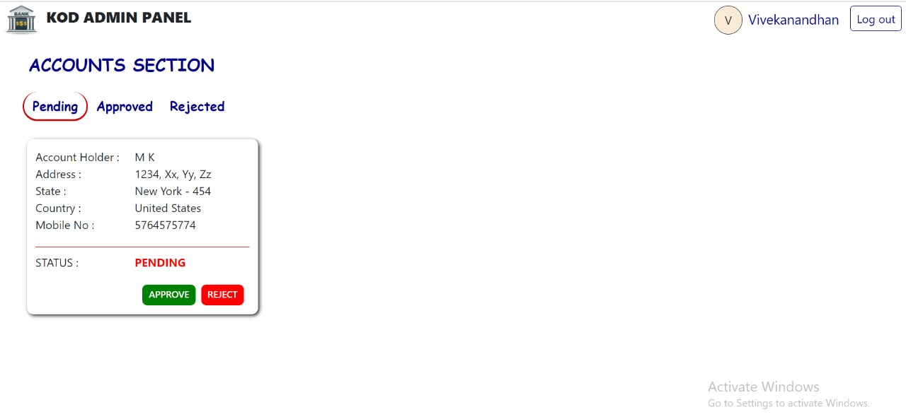
SCREENSHOT OF ACCOUNTS SELECTION MENU - PENDING

Slide 23
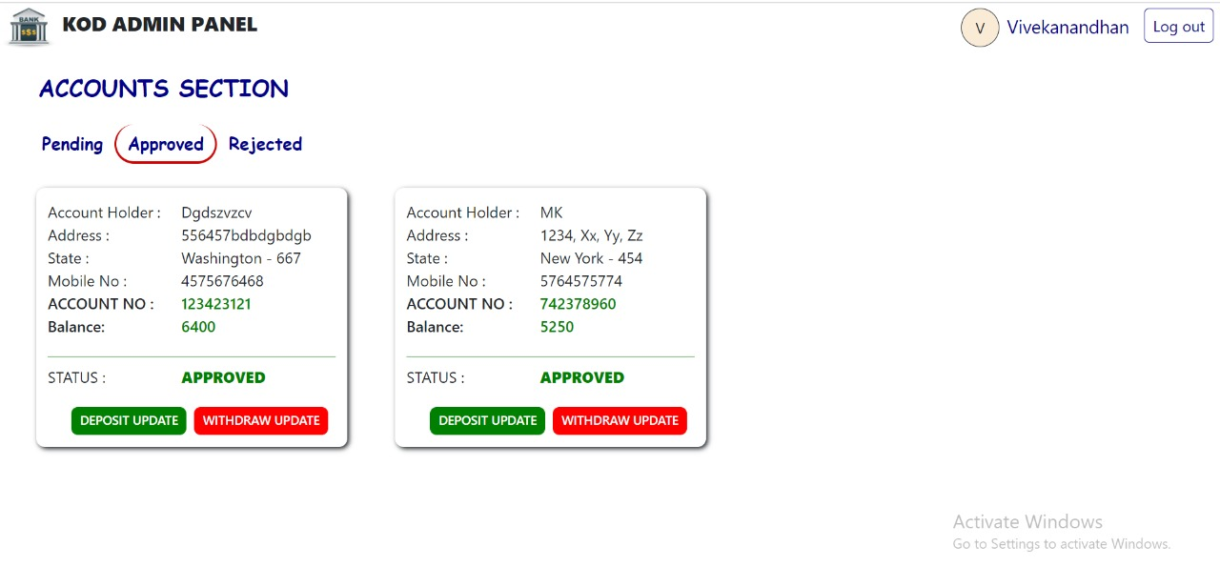
SCREENSHOT OF ACCOUNTS SELECTION MENU - APPROVED

Slide 24
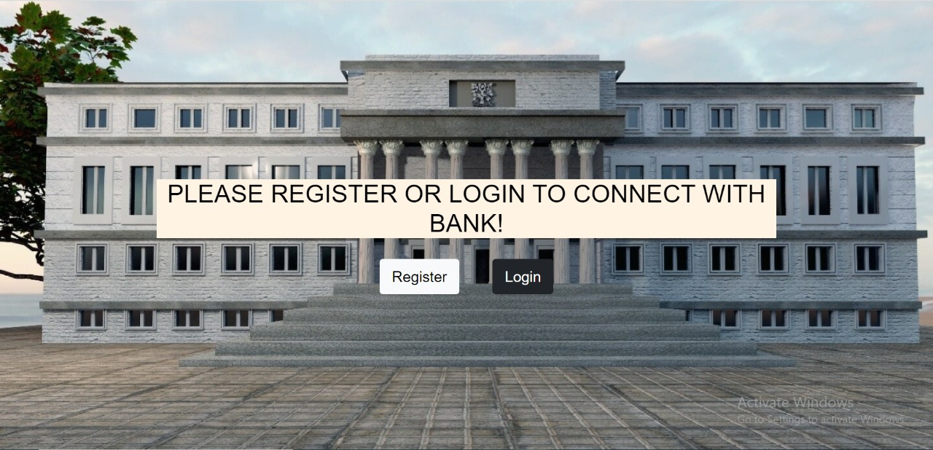
SCREENSHOT OF HOMEPAGE – CUSTOMER PANEL

Slide 25
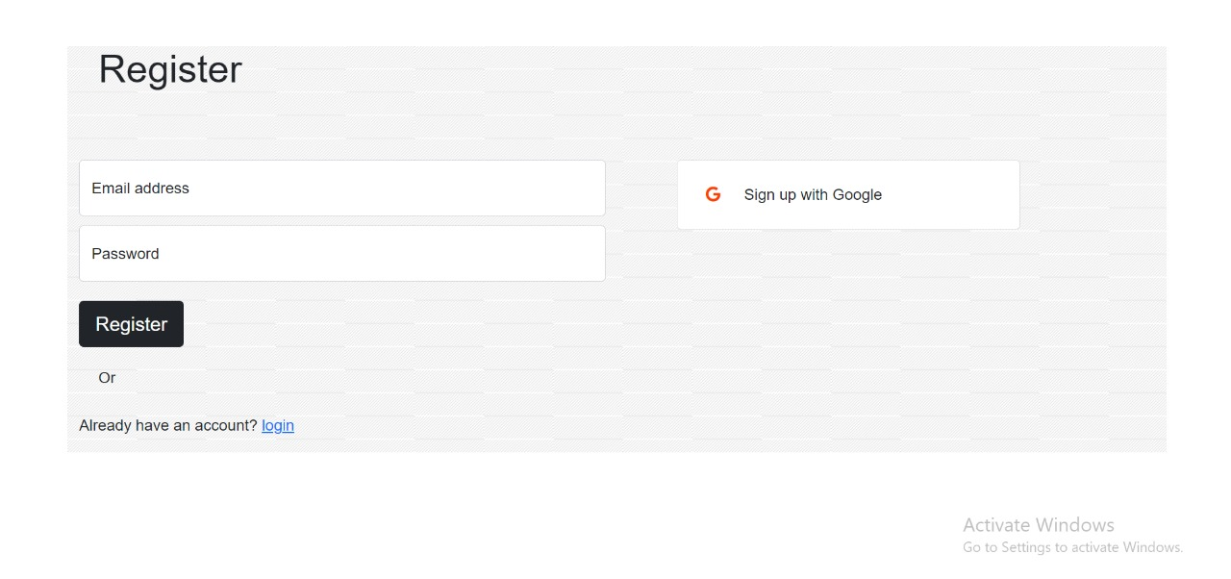
SCREENSHOT OF REGISTER INTERFACE – CUSTOMER PANEL

Slide 26
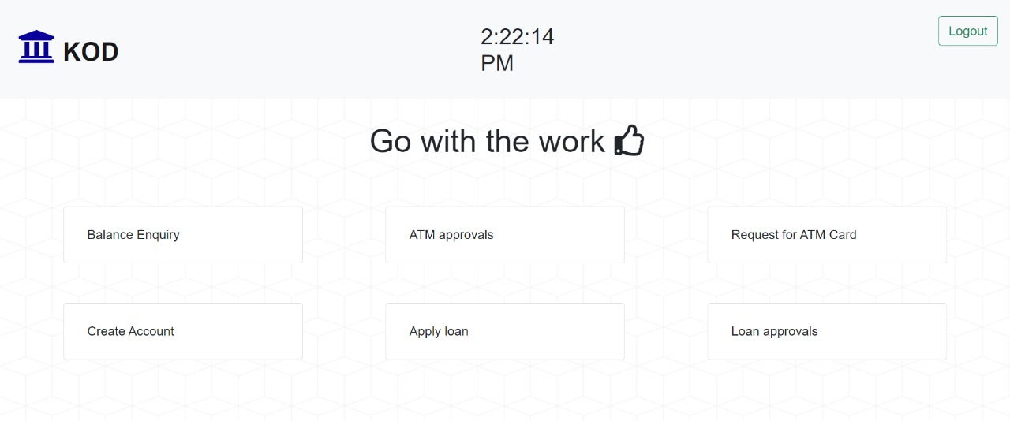
SCREENSHOT OF CUSTOMER PANEL MODULES

Slide 27
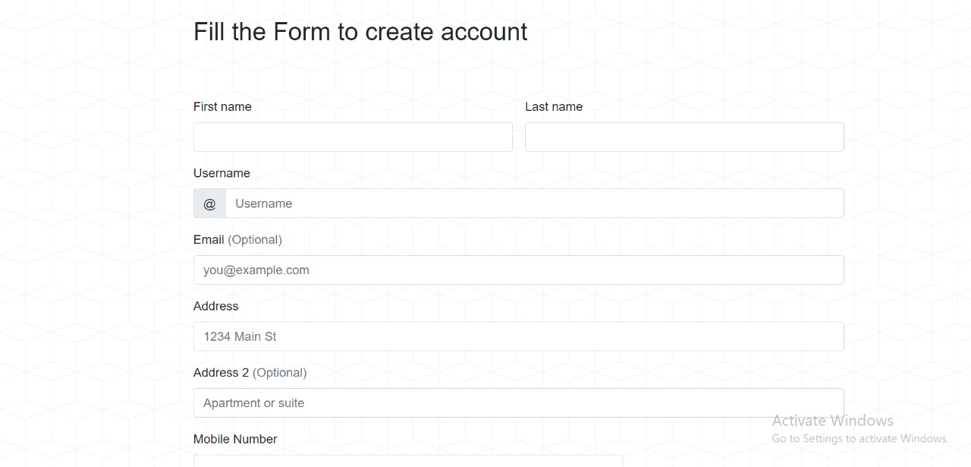
FORM FOR ACCOUNT CREATION

Slide 28
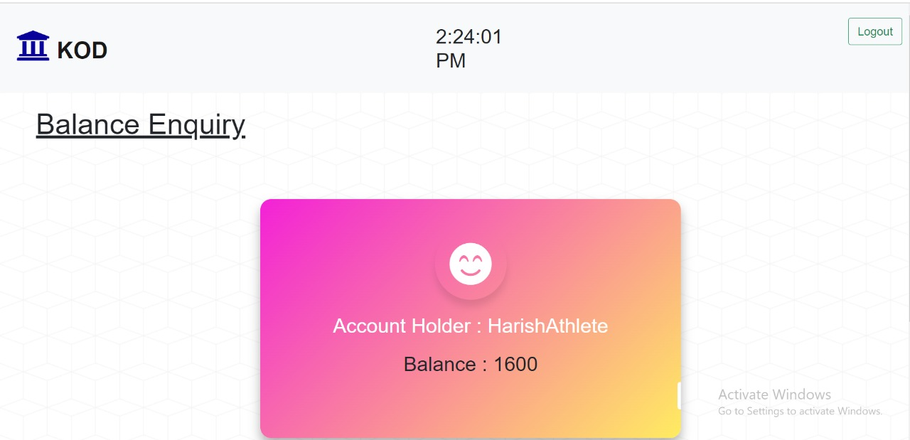
BALANCE ENQUIRY DETAILS

Slide 29

Thank you

